Slide 1
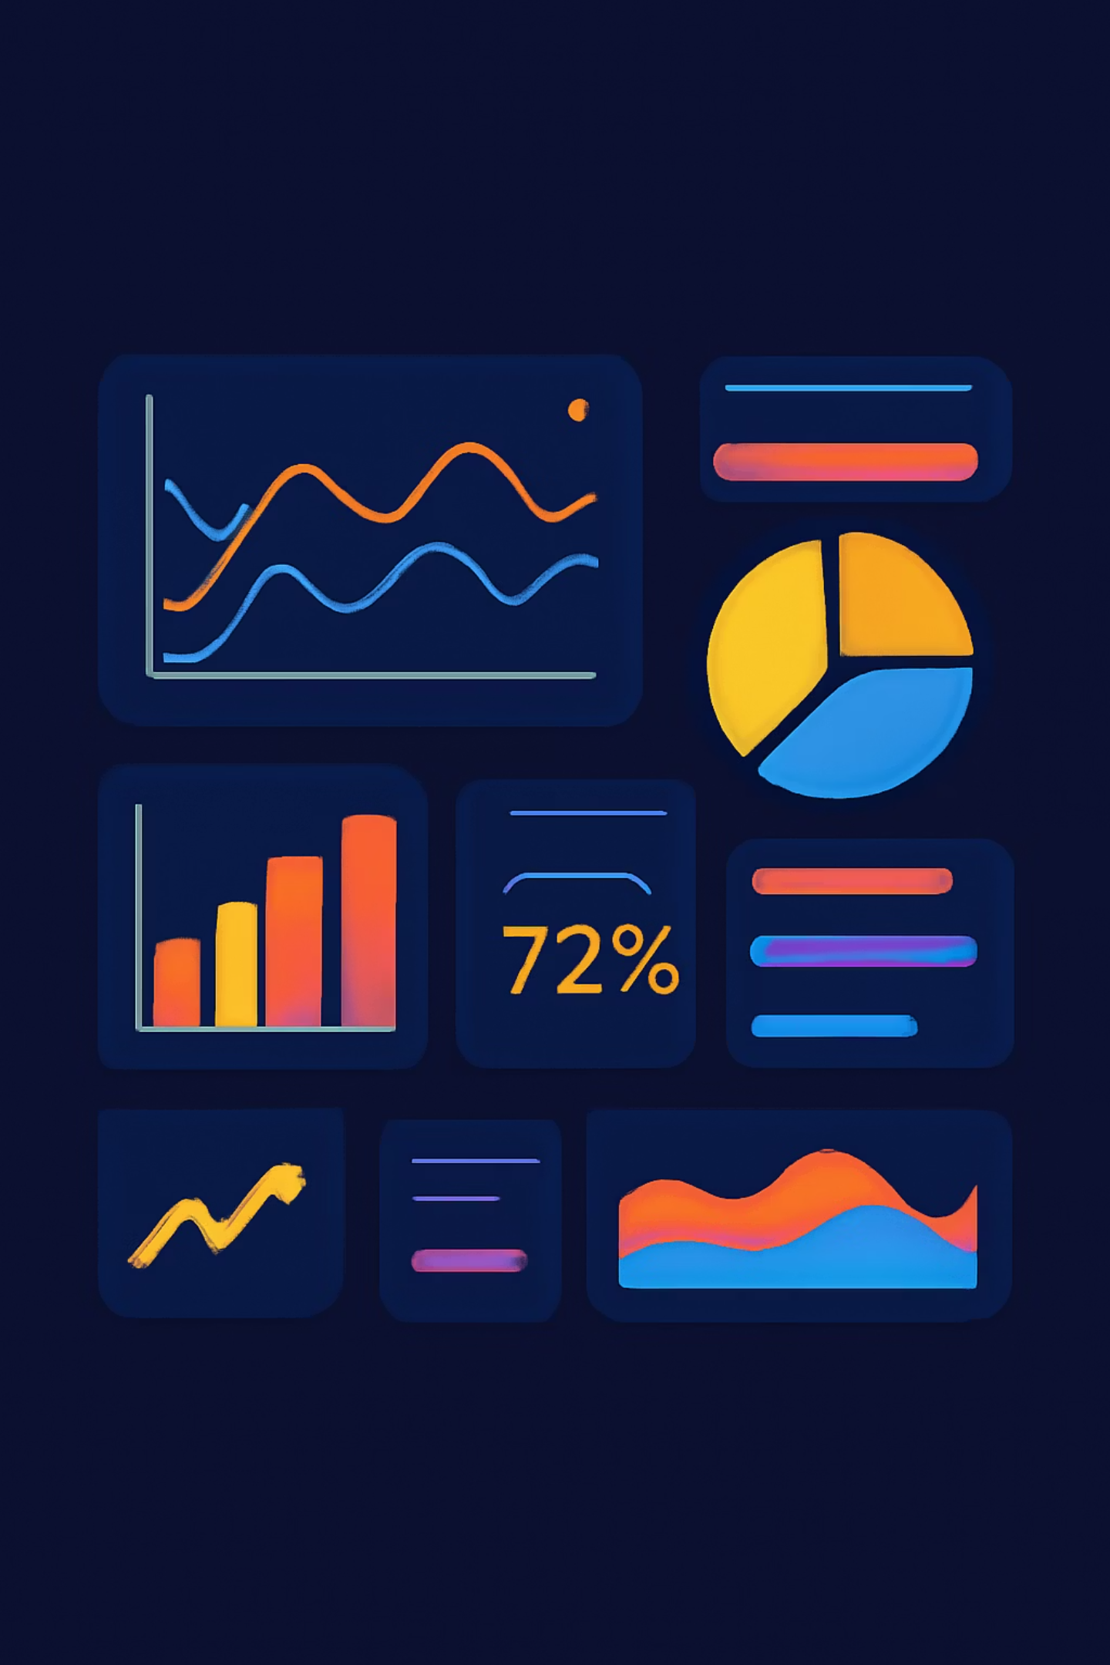
Customer Shopping Behavior Analysis
Uncovering spending patterns, customer segments, product preferences, and subscription behavior from 3,900 transactions to guide strategic business decisions.

Slide 2

Dataset at a Glance
3,900
18
Transactions
Columns
$59.76
3.75
Avg. Purchase
Avg. Rating
Key Features
Demographics: Age, Gender, Location, Subscription Status
Purchase Details: Category, Amount, Season, Size, Color
Behavior: Discounts, Promo Codes, Purchase Frequency, Shipping Type
37 missing values in Review Rating — imputed using category median.

Slide 3

Data Preparation in Python
01
Load & Explore
Imported dataset with pandas; used df.info() and .describe() for initial inspection.
02
Clean & Standardize
Imputed missing Review Ratings; renamed columns to snake_case; dropped redundant promo_code_used.
03
Feature Engineering
Created age_group bins and purchase_frequency_days from purchase data.
04
Database Integration
Loaded cleaned DataFrame into PostgreSQL for structured SQL analysis.

Slide 4
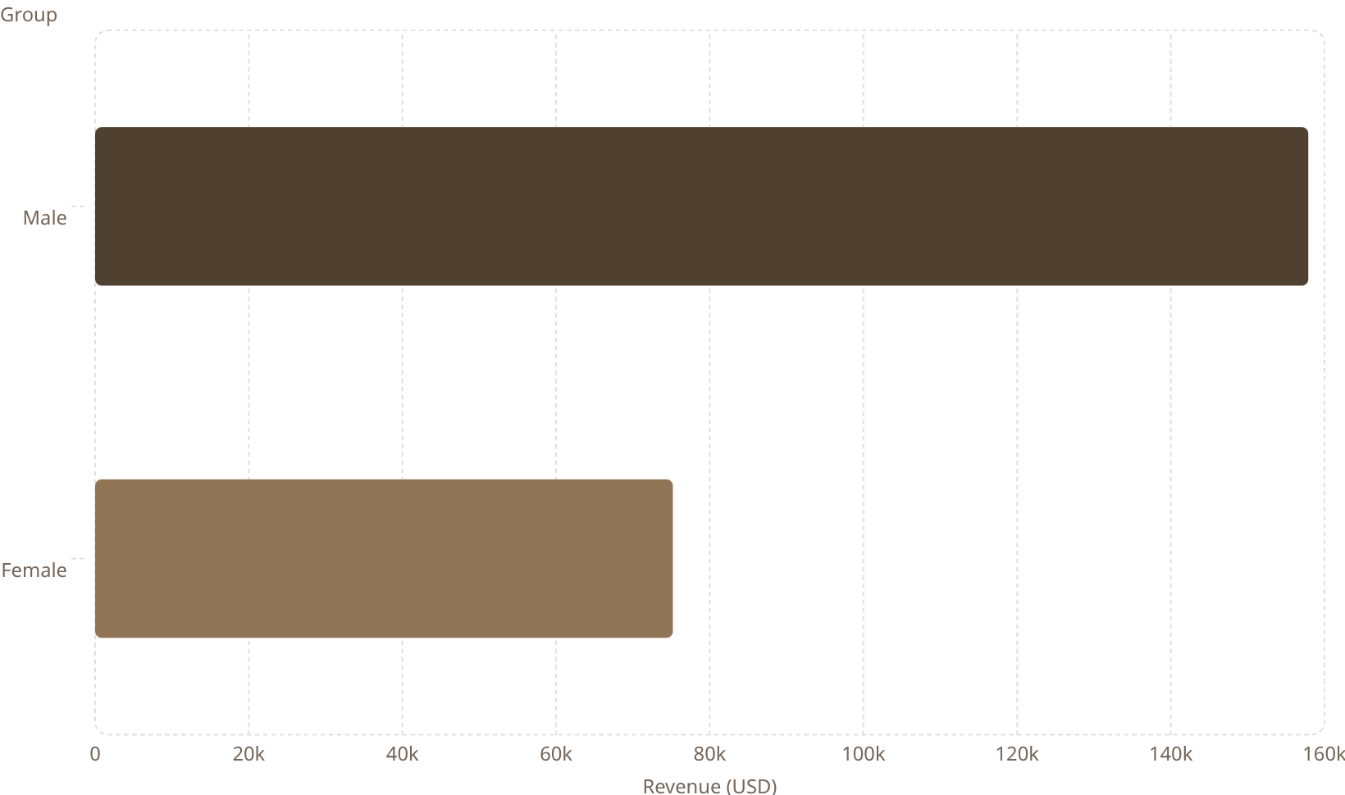
Revenue & Spending Insights
Key Findings
Male customers generated $157,890 vs. female customers' $75,191 in total revenue.
839 customers used discounts yet still spent above the average purchase amount.
Express shipping users averaged $60.48 vs. Standard at $58.46 — a modest but notable difference.
158k
75.2k

Slide 5
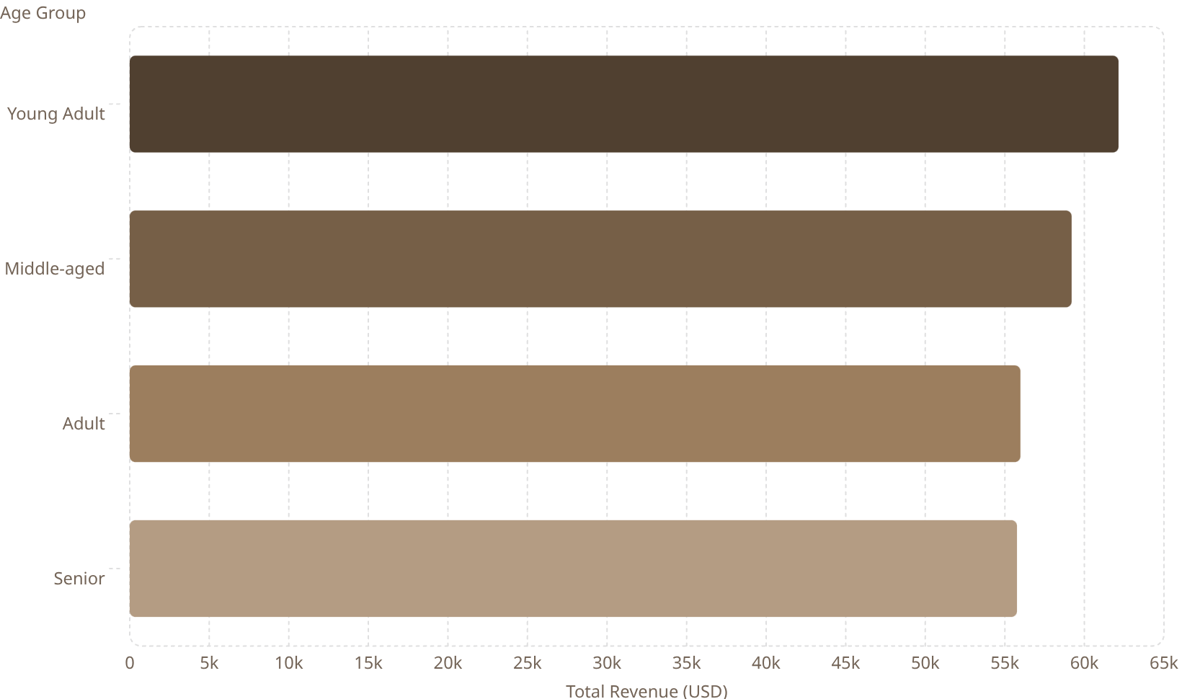

Revenue by Age Group
Age Group Breakdown
62.1k
Young Adults lead revenue contribution at $62,143, followed closely by Middle-aged customers at $59,197.
59.2k
All age groups contribute meaningfully, with Seniors at $55,763 — indicating broad demographic reach.
56k
Targeted marketing toward Young Adults and Middle-aged segments offers the highest revenue upside.
55.8k

Slide 6
Product Performance
Top 5 Products by Rating
Top Products by Category
Product
Avg. Rating
Category
#1 Product
Orders
Gloves
3.86
Accessories
Jewelry
171
Sandals
3.84
Clothing
Blouse
171
Boots
3.82
Footwear
Sandals
160
Hat
3.80
Outerwear
Jacket
163
Skirt
3.78

Slide 7

Discount & Subscription Behavior
Discount-Dependent Products
Products with the highest share of discounted purchases:
50%
49.66%
49.07%
48.17%
Hat
Sneakers
Coat
Sweater
47.37%
Pants
Subscribers vs. Non-Subscribers
Status
Customers
Avg. Spend
Total Revenue
Subscribed
1,053
$59.49
$62,645
Non-Subscribed
2,847
$59.87
$170,436
Average spend is nearly identical — subscription drives volume, not higher individual spend.

Slide 8

Customer Segmentation
2.13%
Segment Breakdown
17.97%
Among customers with >5 purchases, 958 are subscribed vs. 2,518 non-subscribed — repeat buyers skew non-subscriber.
Loyal·79.9%
·79.9%
·
Returning·17.97%
·17.97%
·
New·2.13%
·2.13%
·
79.9%
Loyal — 3,116
Returning — 701
New — 83
The dominant segment. High purchase history, strong retention.
Repeat buyers with growth potential toward Loyal status.
Small but valuable pipeline for future loyalty conversion.

Slide 9
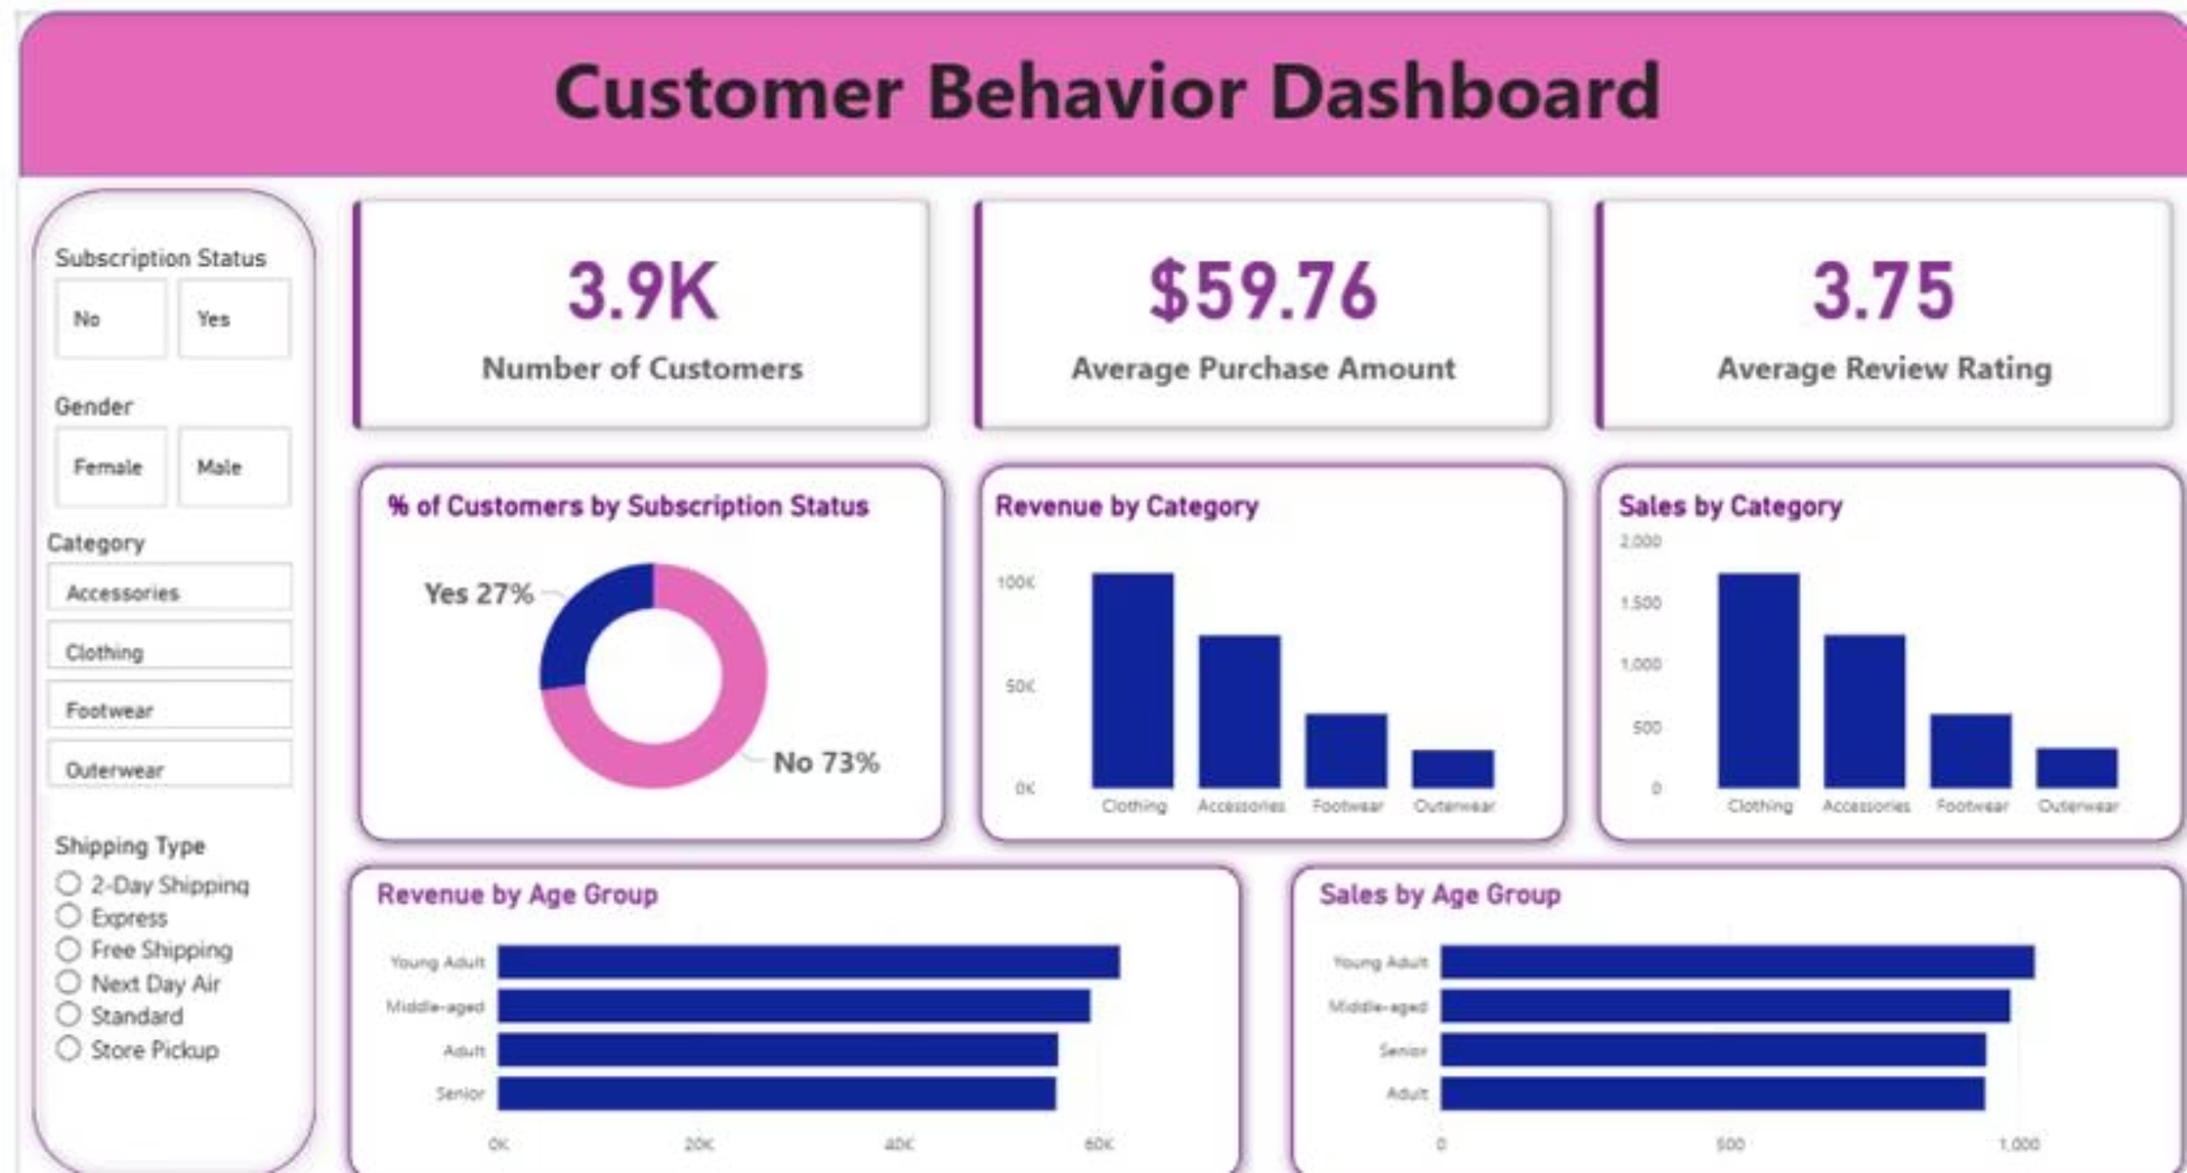
Power BI Dashboard
An interactive dashboard visualizes all key insights with filters for Subscription Status, Gender, Category, and Shipping Type — featuring donut, bar, and horizontal bar charts across revenue and sales dimensions.

Slide 10

Business Recommendations
Boost Subscriptions
Loyalty Programs
Review Discount Policy
Promote exclusive benefits to convert non-subscribers.
Reward repeat buyers to accelerate movement into the Loyal segment.
Balance sales boosts with margin control on high-discount products.
Targeted Marketing
Product Positioning
Focus on high-revenue age groups and express-shipping users.
Highlight top-rated and best-selling products in campaigns.

